Slide 1


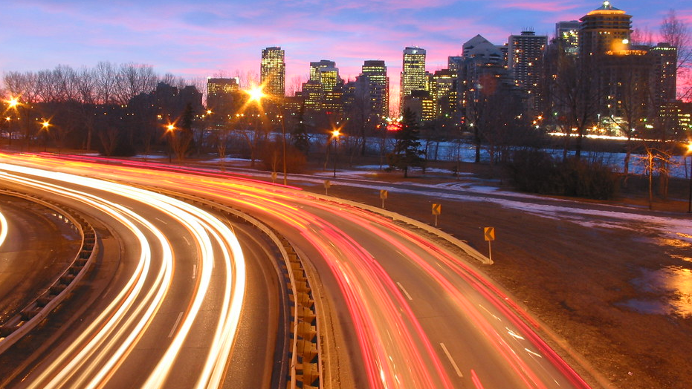
Investigating Traffic Fatalities
SOURCE: Unites States Department Of Transportation's National Highway Traffic Safety Administration (NHTSA) Data from 2019 and 2020 (BIGQUERY)
This Photo by Unknown Author is licensed under CC BY-NC-ND

Slide 2
The background

Slide 3

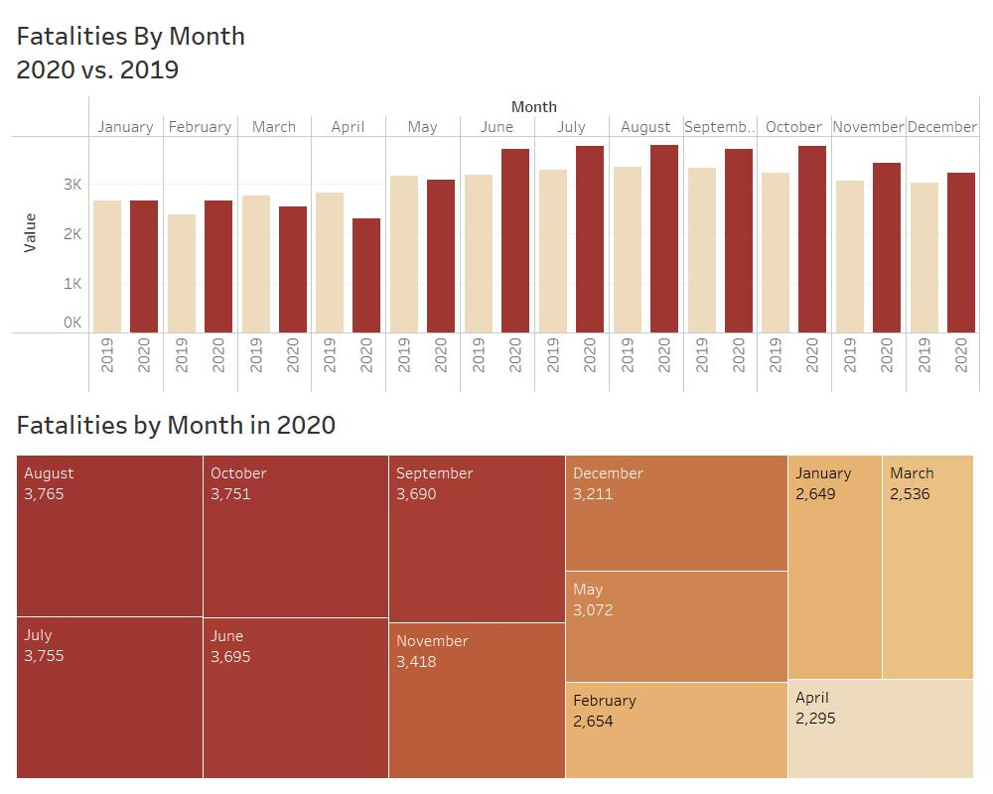
Weather vs. Light Conditions
2020 had more accidents than 2019
The maximum number of accidents were recorded during the mid year months

Slide 4
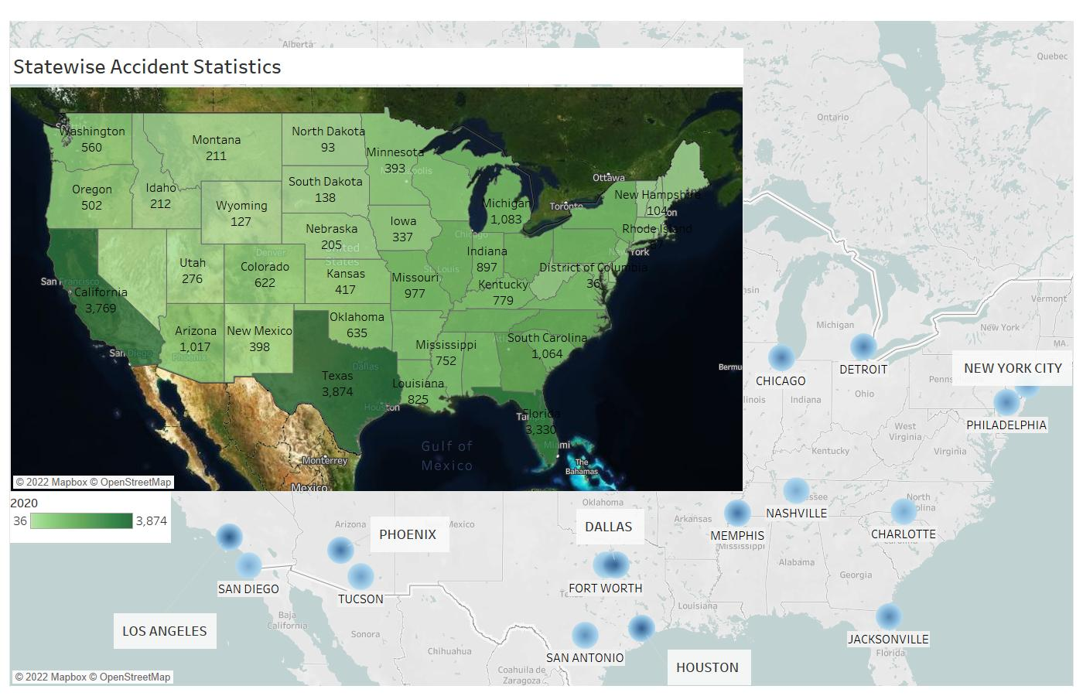
State wise accident statistics
Highest Accident States – Texas, California, Florida
Top metropolitan cities have maximum accidents

Slide 5
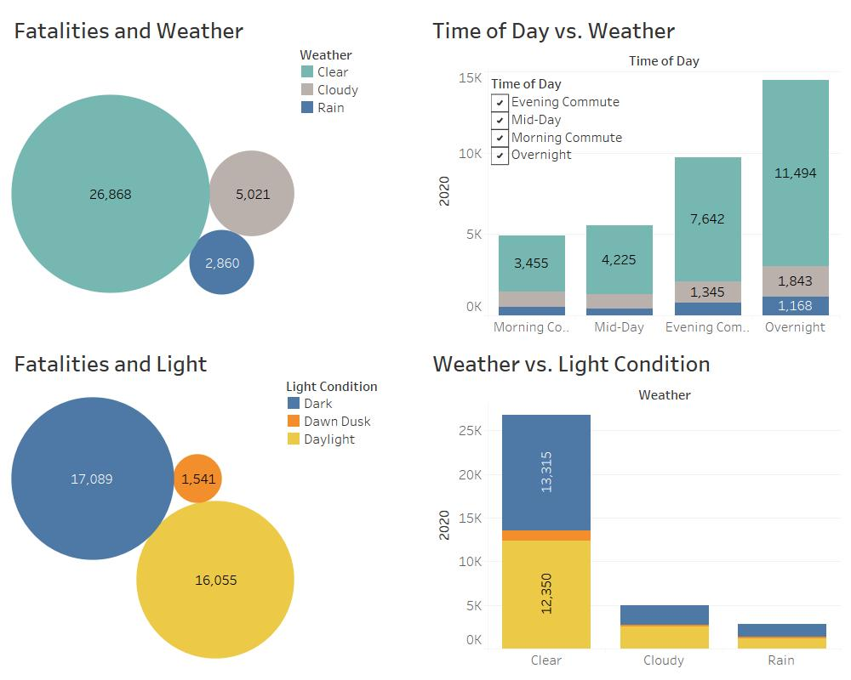
Weather, Light Conditions & Time of day
More accidents occur under the following conditions:
Clear Weather
Dark light conditions
Overnight travel

Slide 6
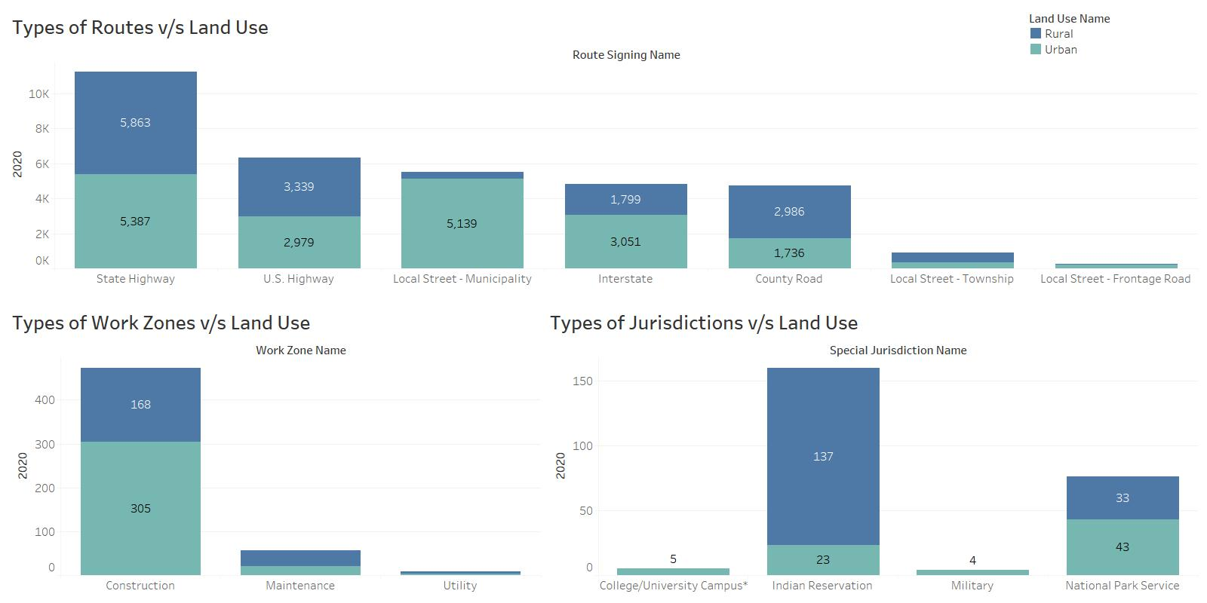
Area wise accidents
Highest Accidents occur in:
State Highways
Construction work zones
Indian Reservation Jurisdictions

Slide 7
The Data and Purpose
Source: Unites States Department Of Transportation's National Highway Traffic Safety Administration (NHTSA) Data from 2019 and 2020 (BIGQUERY)
Objective: To understand the factors responsible for road accidents across states in USA:
Weather, Lights Conditions and Commute Timings
State and City Wise
Type of road, work zone and jurisdiction wise
Data: This data set was chosen because it includes numerous features involving factors responsible for accidents for multiple years. We have taken 2019 and 2020 into consideration.
Cleaned up data by removing Null values and other non-conclusive data
Created a calculated column for Commute Timings - Morning Commute (6 a.m.-11 a.m.), Mid-Day (11 a.m.-3 p.m.), Evening Commute (3 p.m.-8 p.m.) and Night (8 p.m.-6 a.m.)

Slide 8
The Story
2020 has more fatalities than 2019 but similar monthly pattern - 38,491
More fatalities occur in summer months
State wise the highest number of accidents are recorded in – Texas, California, Florida
City wise the highest number of accidents are recorded in the busiest cities in the above states
Most fatalities occur during clear weather
Bad weather does not appear to increase likelihood of fatality
Most fatalities occur during the evening commute or overnight hours - Suggests that fatigue is the most significant role in fatal accidents
State Highways, Construction work zones and Indian Reservation Jurisdictions have maximum number of accidents in the Urban areas
More fatalities occur on the weekend
Drunk Drivers were involved in 20—30% of incidents

Slide 9

Questions?

Slide 10

Thank YOU

